Slide 1
“THE MILLENNIALS”
Guide:
Assistant Prof. Dhaval Bhoi
Prepared by:
Prachi Desai (22CE025)
Smit Gandhi (22CE031)
Dhruvil Joshi (22CE044)

Slide 2
TABLE OF CONTENTS
About the project……………………………………………………………………………………3
Description of our project
Technologies………………………………………………………………………………………...4
Technologies used
Why The Millennials?………………………………………………………………………………5
Logo of the website
Features of website
Screenshots……………………………………………………………………………………...….7
Screenshots of Website
Updates in the website………………………………………………………………………...….16
Updates added in the website
Upcoming updates

Slide 3
ABOUT THE PROJECT
This is a web development project of a Gaming website(online free games simulator)
“The Millennials” aims to display childhood on digital platform
This website allow users to experience their childhood games with a pinch of tech which gives them feeling of nostalgia and despite being any age they can recall their good old days.
It contains various games having their own extra elements as well as maintains it’s own ethinicity.

Slide 4
TECHNOLOGIES
The languages used in creating, designing and making our website user-interactive are:
HTML (HyperText Markup Language) : To create skeleton of website
CSS (Cascading Style Sheets) : To design and animate webpage
JavaScript : To make the website user-friendly and add various functions to it

Slide 5


Why The Millennials?

Slide 6
FEATURES
Nostalgic
Mind-Refreshing
Responsive Design
Easy Navigation
Appealing UI and UX
Updates with regular interval

Slide 7
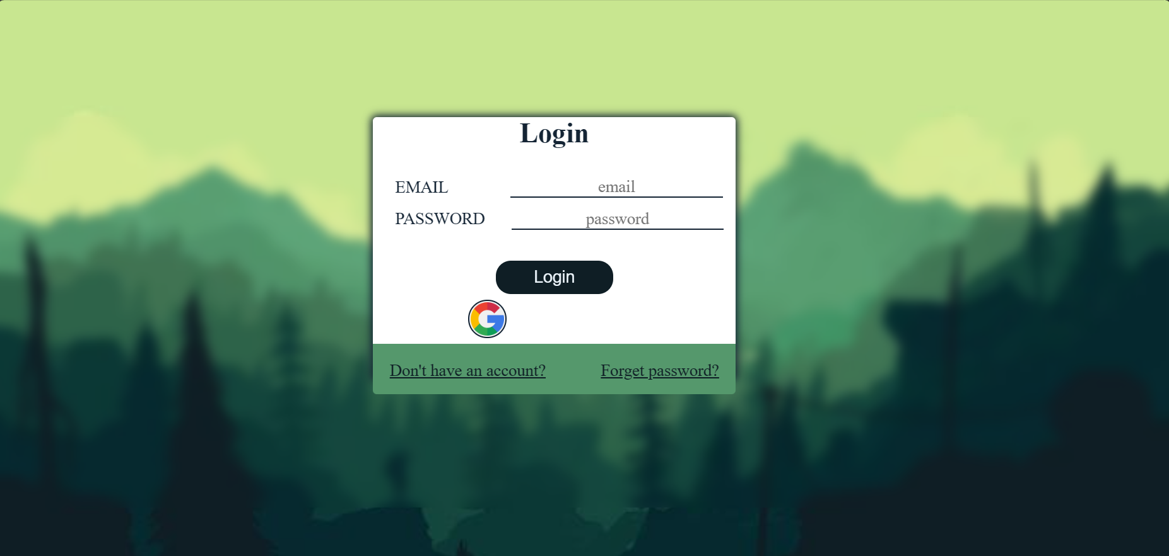
Screenshots (Login Page)

Slide 8
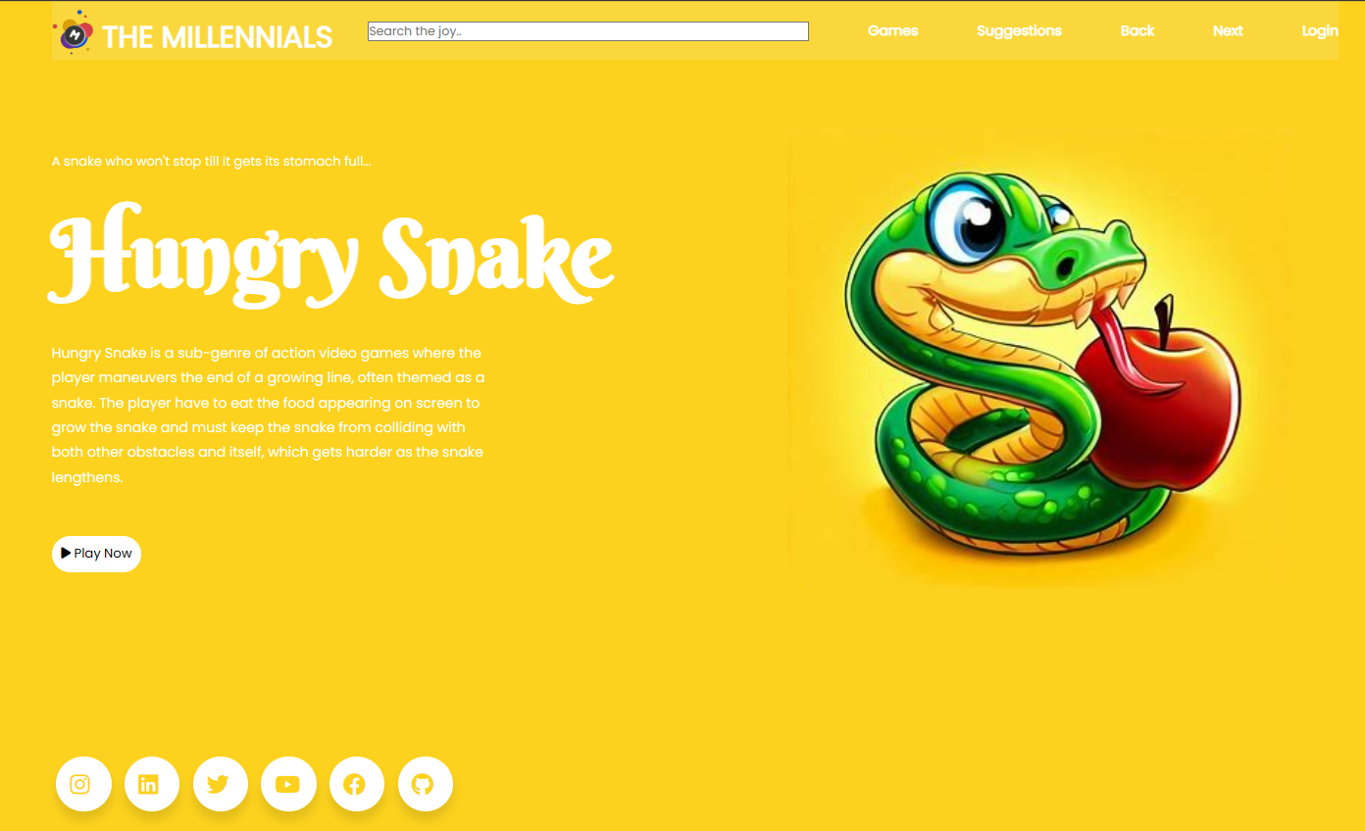
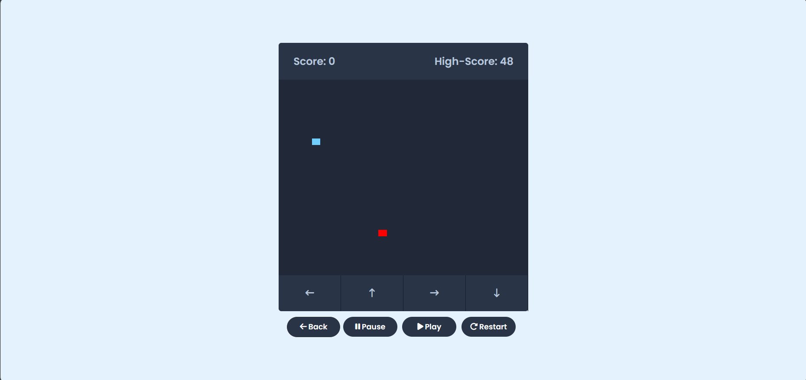
Screenshots
Hungry Snake

Slide 9
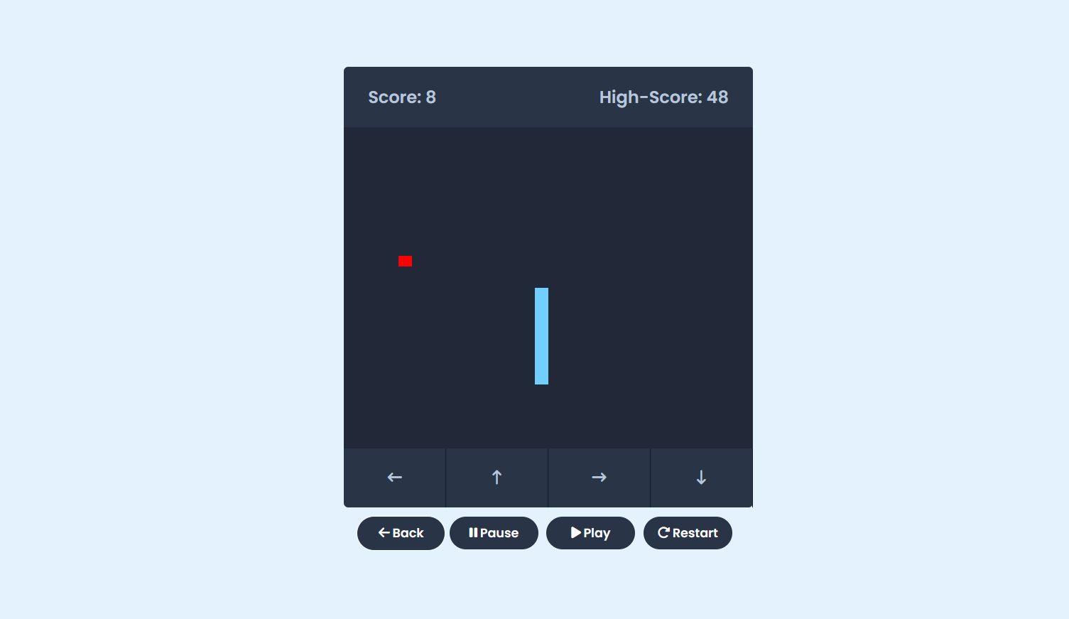
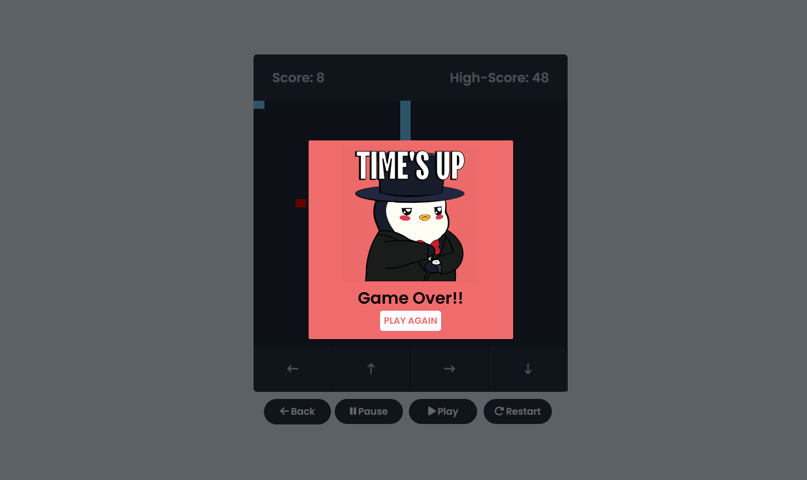
Screenshots
Hungry Snake

Slide 10
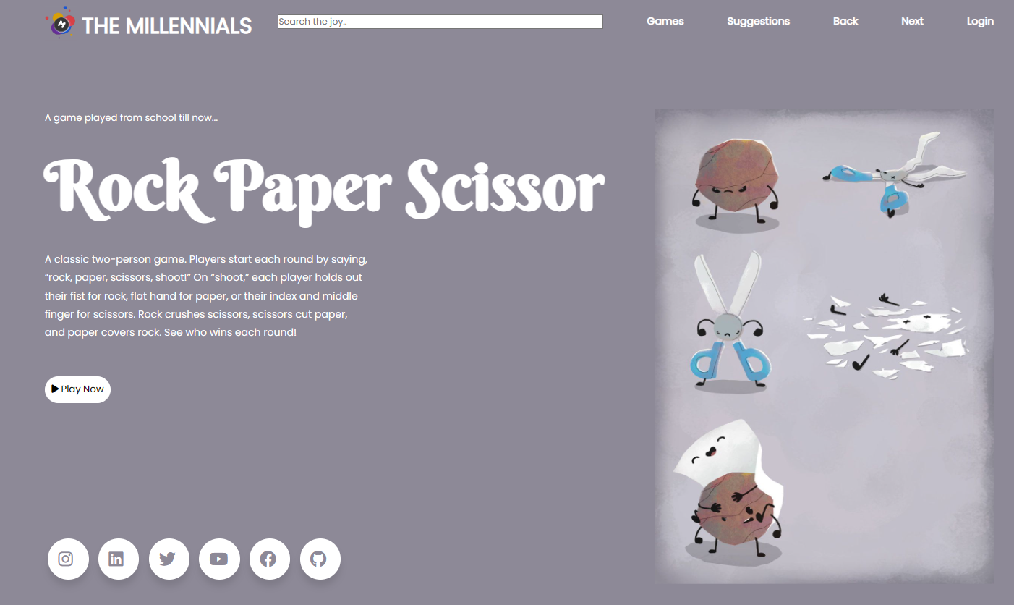
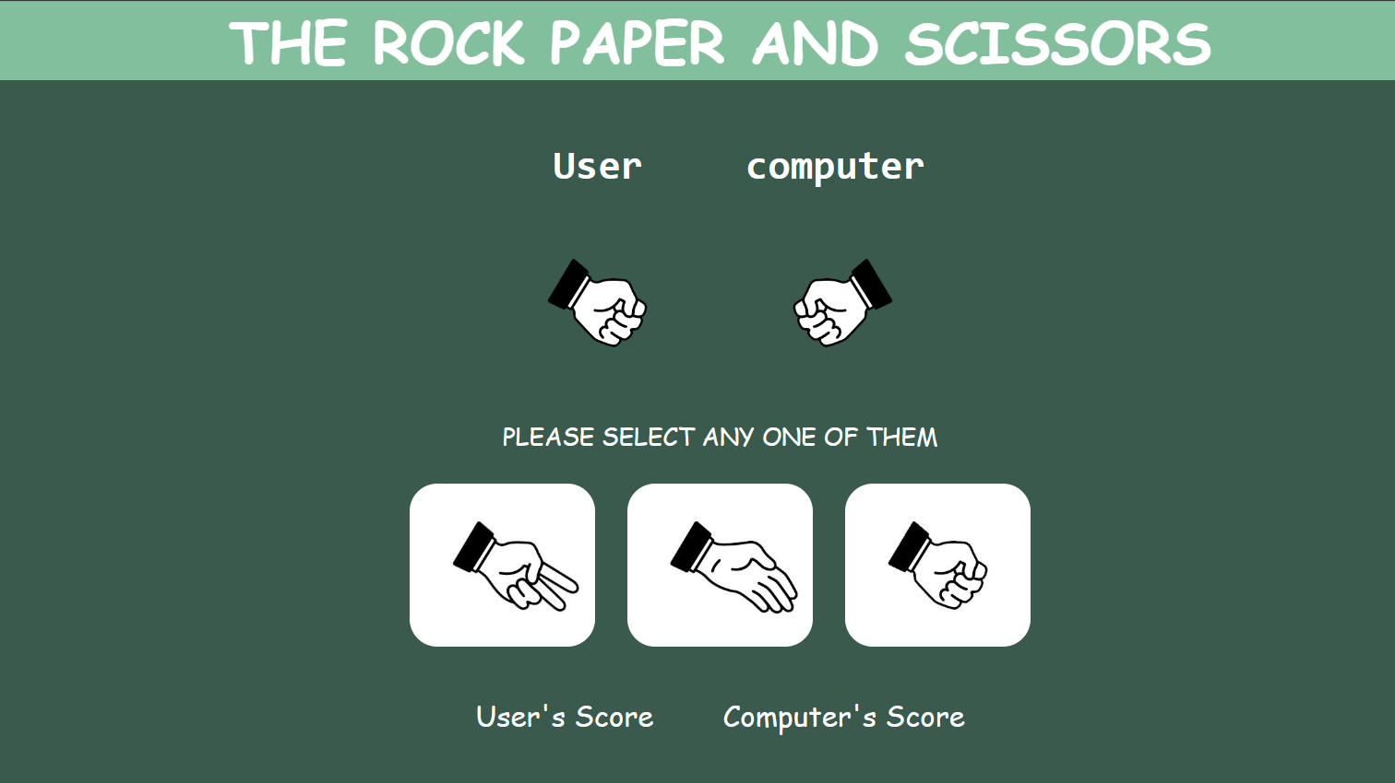
Screenshots
Rock Paper Scissors

Slide 11
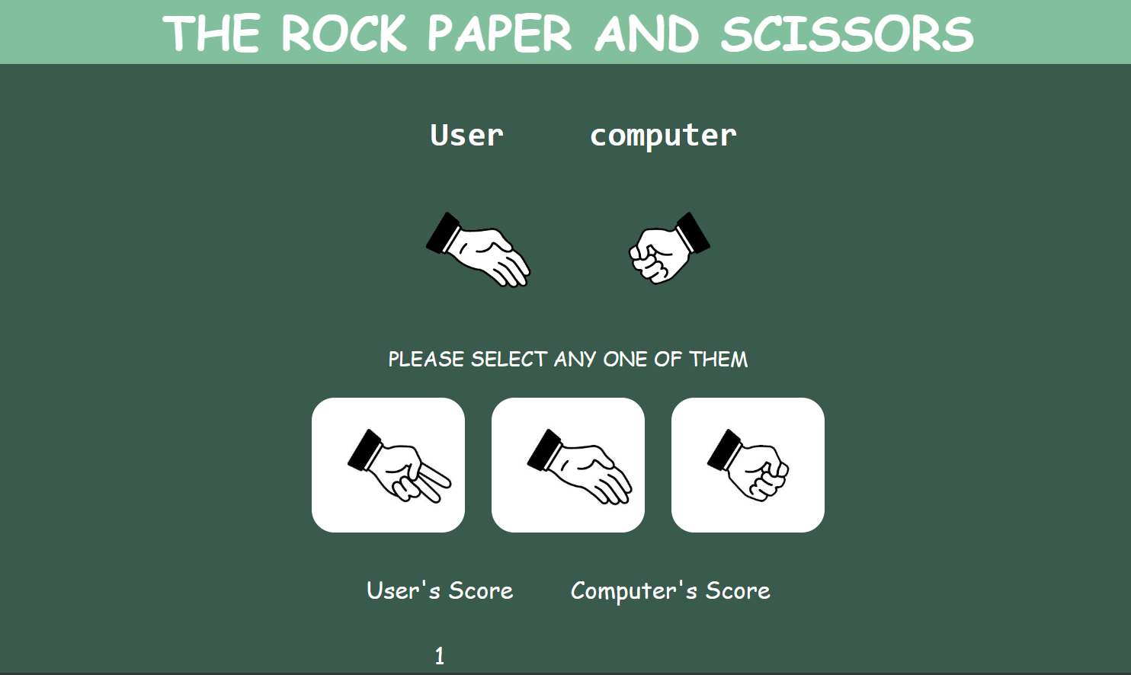
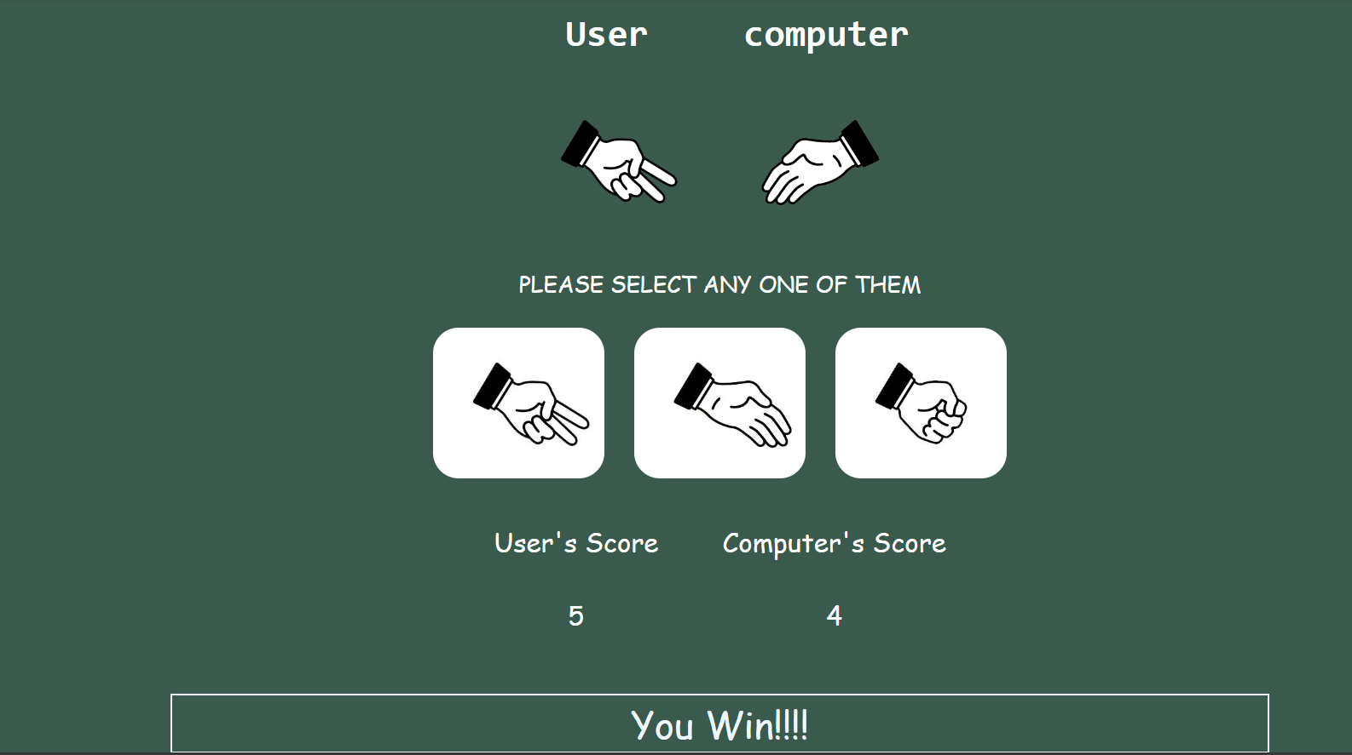
Screenshots
Rock Paper Scissors

Slide 12
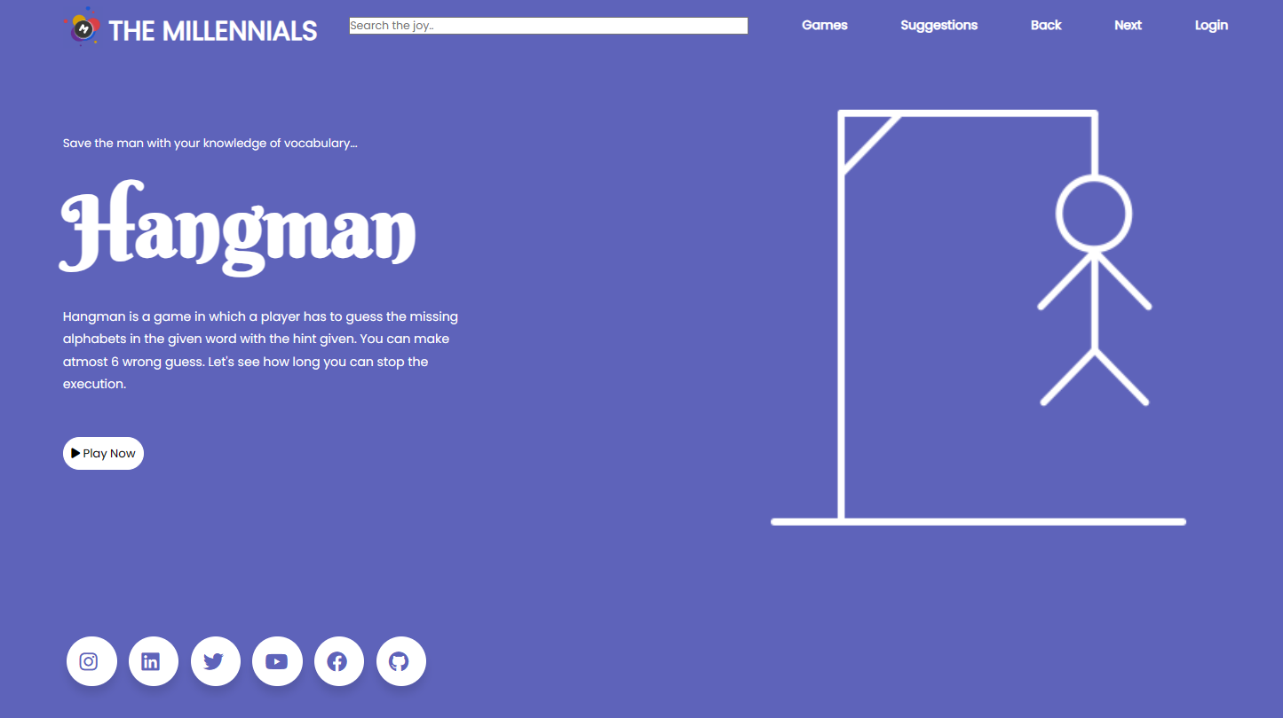
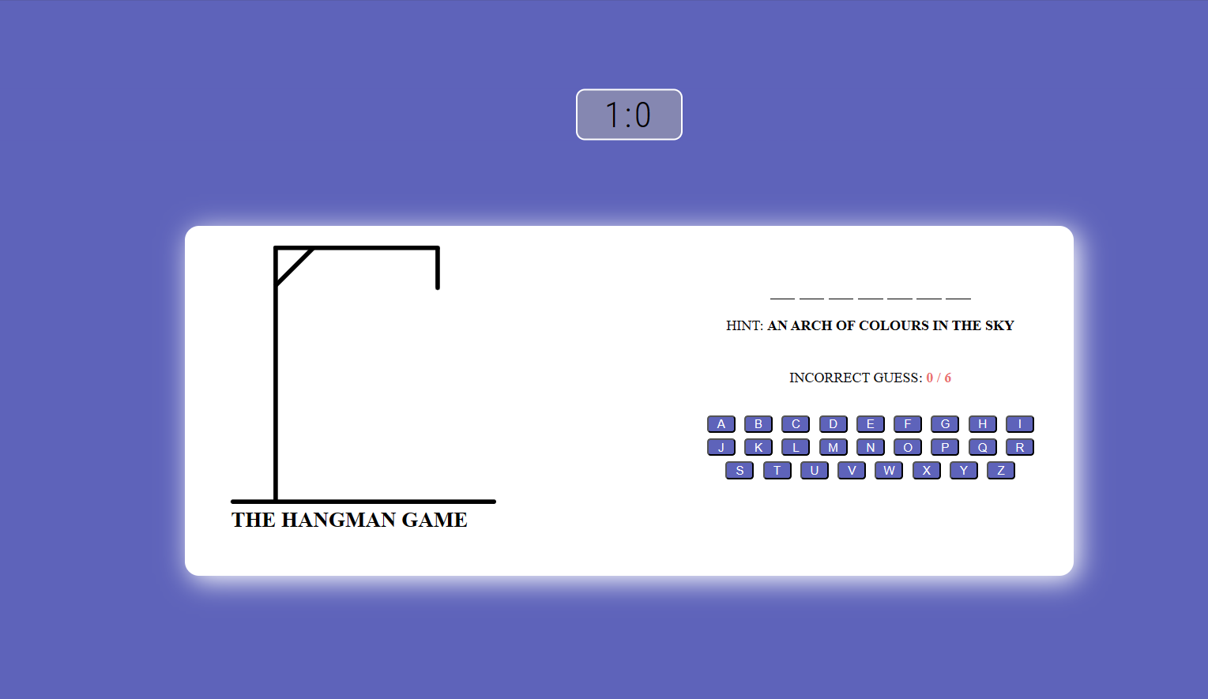
Screenshots
Hangman

Slide 13
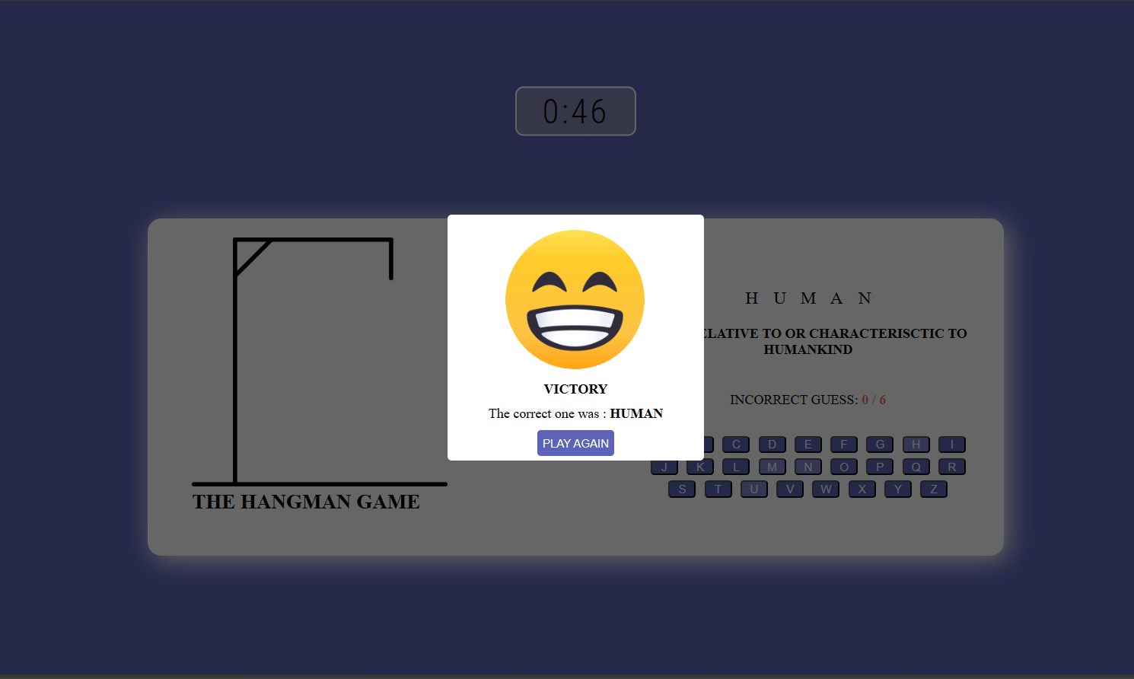
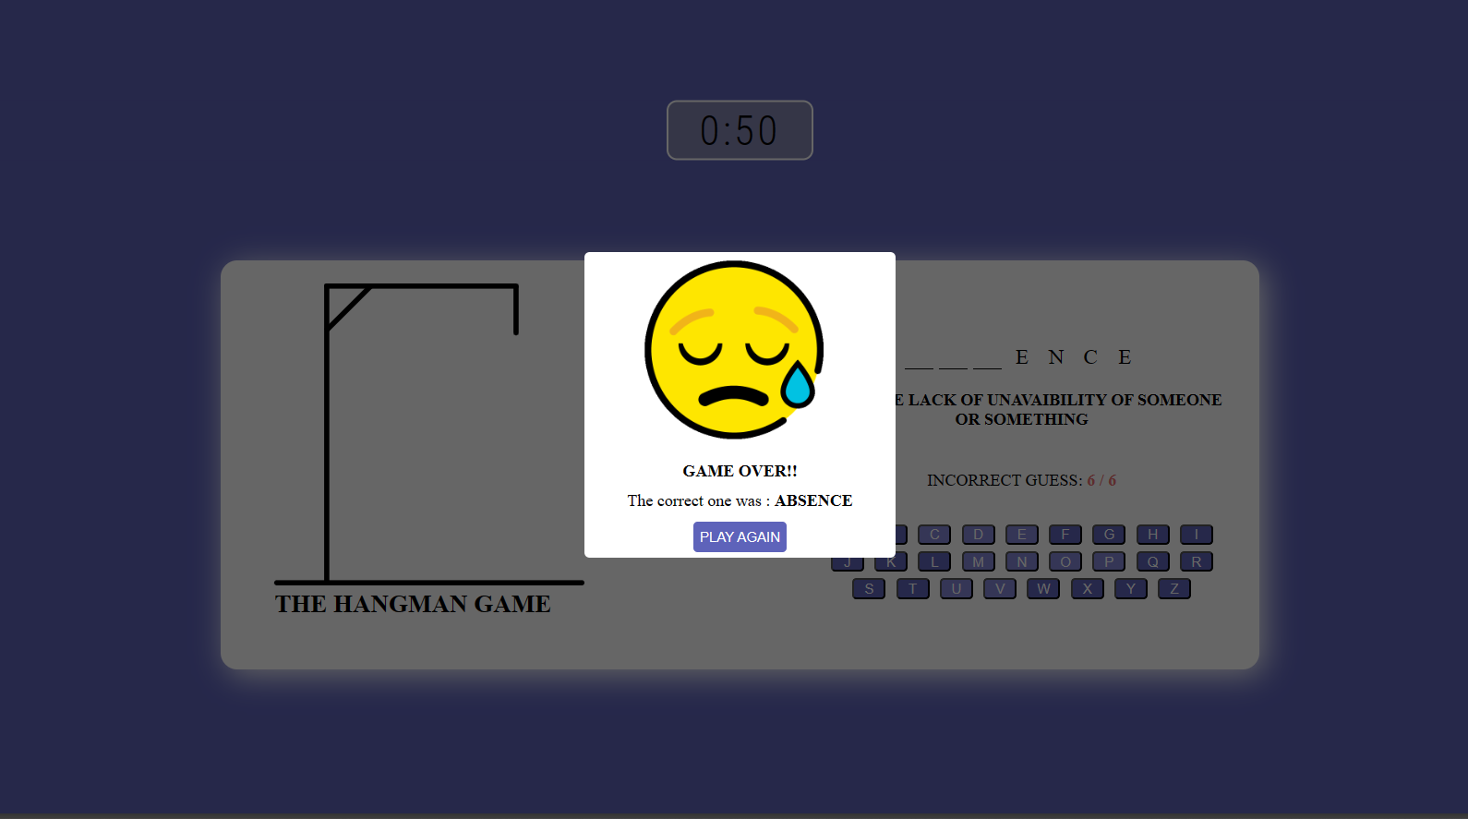
Screenshots
Hangman

Slide 14
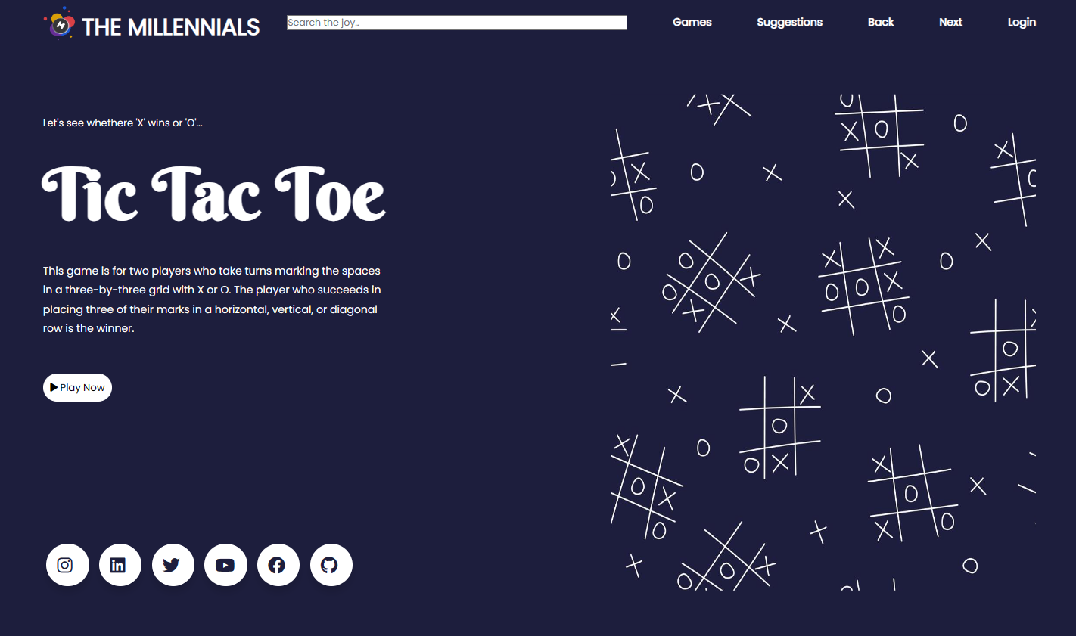
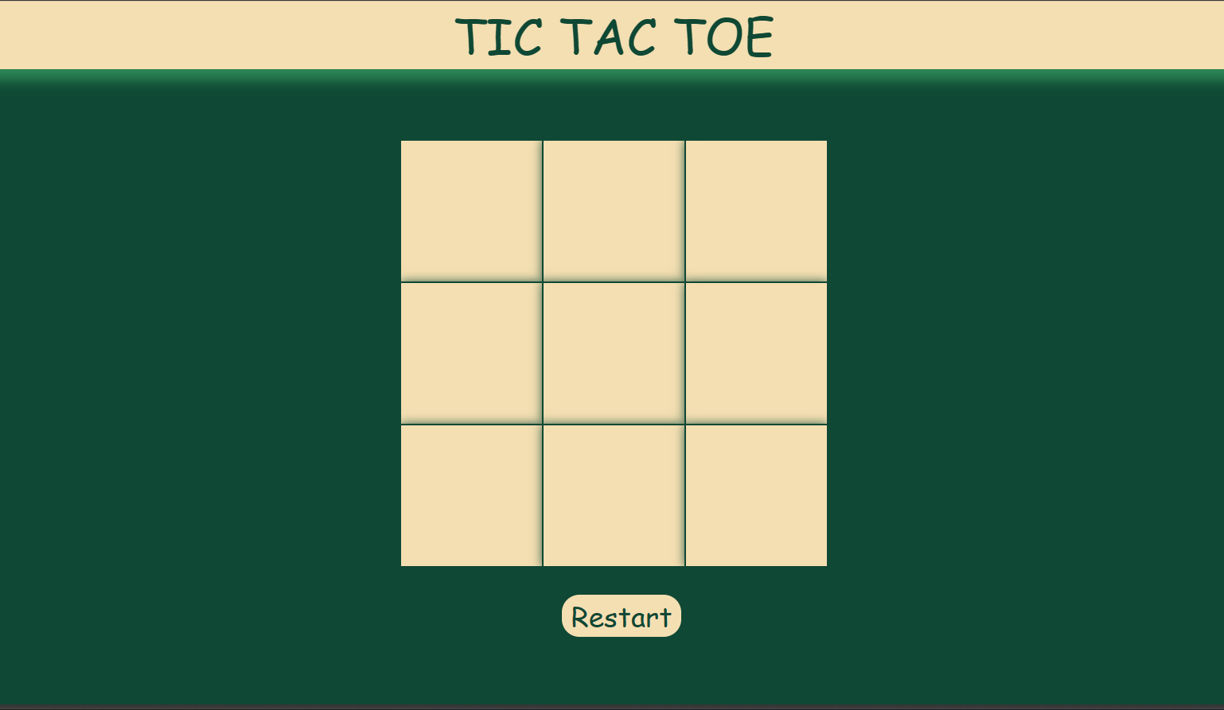
Screenshots
TIC TAC TOE

Slide 15
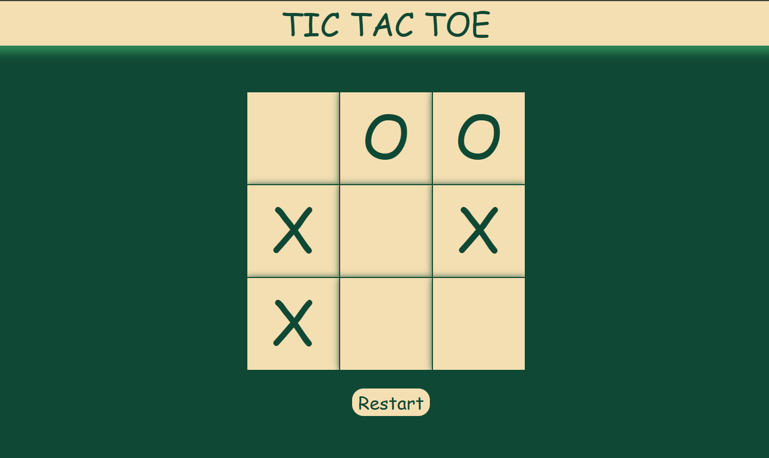
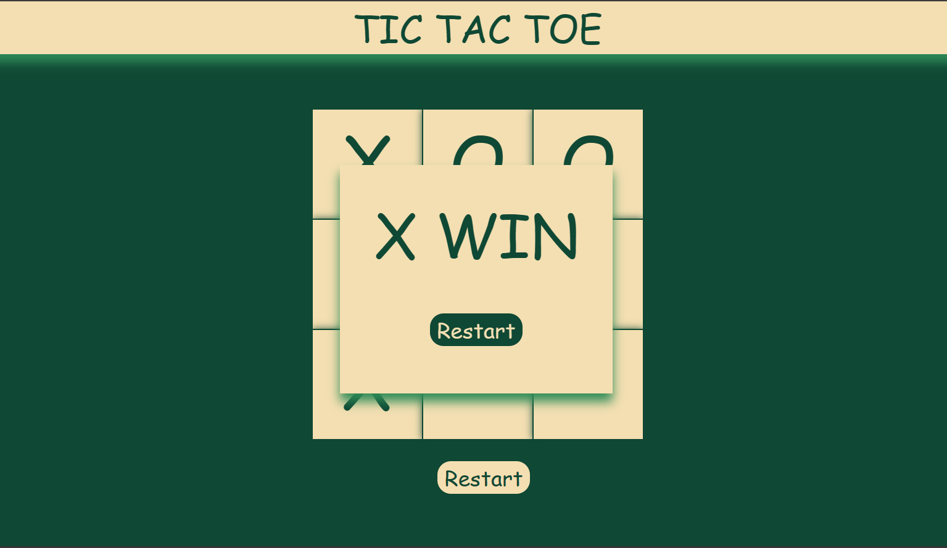
Screenshots
TIC TAC TOE

Slide 16
Updates added in the website
Login Page
Website Intro Animation
Hangman Countdown Timer

Slide 17
Upcoming updates
Login by Google Account using Google Oauth
Tic Tac Toe with a puzzle version
Suggestion box for suggestions from user
And many more...

Slide 18
THANK YOU

